Slide 1



OWASP SAMM2 – Your Dynamic Software Security Journey
OWASP Helsinki chapter meeting #39
Tuesday, October 22, 2019

Slide 2
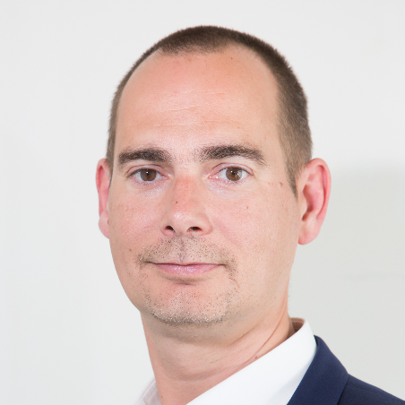
Sebastien Deleersnyder
CEO Toreon
Belgian OWASP chapter founder
SAMM project co-leader
Subscribe to our Threat Modeling Insider newsletter
Guest articles, curated articles, white papers, tips …
http://eepurl.com/ghAr8b

Slide 3
What is SAMM?
"The prime maturity model for software assurance that provides an effective and measurable way for all types of organizations to analyze and improve their software security posture.”

Slide 4
“Build in” software assurance
proactive
reactive
security
requirements /
threat modeling
coding guidelines code reviews static test tools
security testing dynamic test
tools
vulnerability
scanning -
WAF
Design
Build
Test
Production
Secure Development Lifecycle
(SAMM)
● 4 

Slide 5



Why a maturity model?
Measurable
Actionable
Versatile
An organization’s behavior changes slowly over time
Changes must be iterative while working toward long-term goals
There is no single recipe that works for all organizations
A solution must enable risk-based choices tailored to the organization
Guidance related to security activities must be prescriptive
A solution must provide enough details for non-security-people
Overall, must be simple, well-defined, and measurable
OWASP Software Assurance Maturity Model (SAMM)

Slide 6
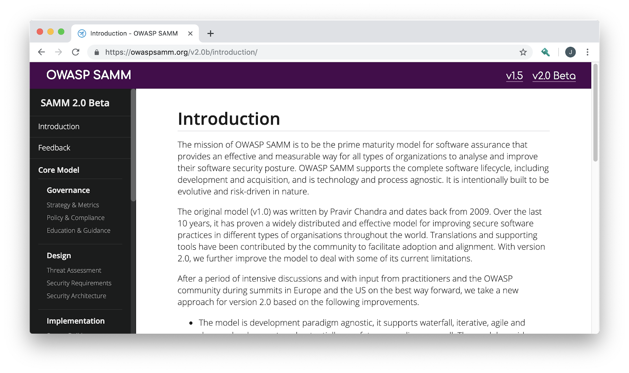
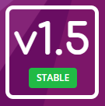
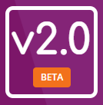
OWASP SAMM
https://owaspsamm.org/

Slide 7
Project History
March 2016
February 2017
BETA – Jan 2019
OWASP SAMM 1.1
OWASP SAMM 1.5
OWASP SAMM 2.0
OpenSAMM 1.0
March 2009
OpenSAMM 1.1
Notes:
Version 1.0 of OpenSAMM was originally created through the OpenSAMM Project led by Pravir Chandra (chandra@owasp.org), an independent software security consultant. Creation of the first draft was made possible through funding from Fortify Software, Inc.
After a number of years, a small group got together at OWASP and worked together to breathe some life into SAMM as an OWASP project.
Version 1.1 of SAMM expanded and restructured its predecessor into four complementary resources:
Core Document: that describes the core SAMM model
How-To Guide: that explains how to apply the model
Quick Start Guide: to help accelerate learning and adoption
Toolbox (spreadsheet): that provides simple automation for data collection, metrics, and graphs.
The project team released v1.5 of SAMM in February 2017, which incorporated a refinement of the scoring model, to provide more granularity to the scoring in an assessment. Now an organization will get credit for all the related work done in a practice rather than having the base number held at the highest completed maturity level.
The updated scoring model was designed to help SAMM assessors and organizations avoid the awkward discussion on whether to mark an answer yes or no when it is honestly something in between, and to show incremental improvements.
The project team began working in earnest on Version 2.0 in late 2017, and officially released the Beta draft for comment at the end of January. In this update, we’ve expanded the breadth of business functions and practices covered, and are working through improvements to the the scoring model to include additional factors.

Slide 8
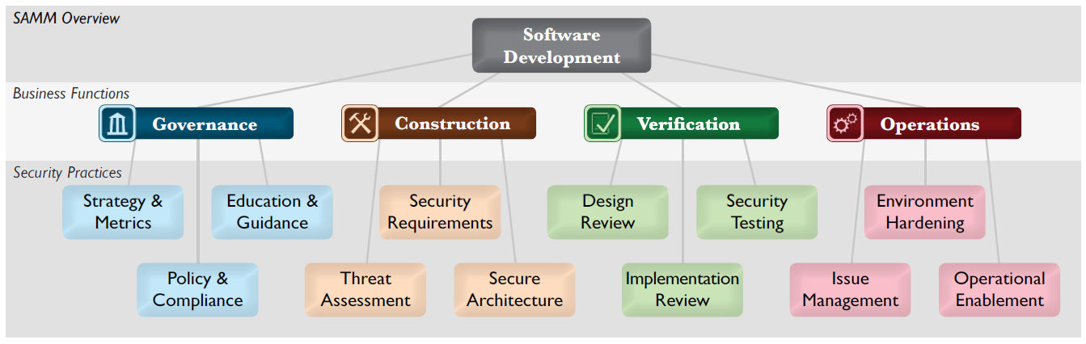
Core structure (v1.5)

Slide 9
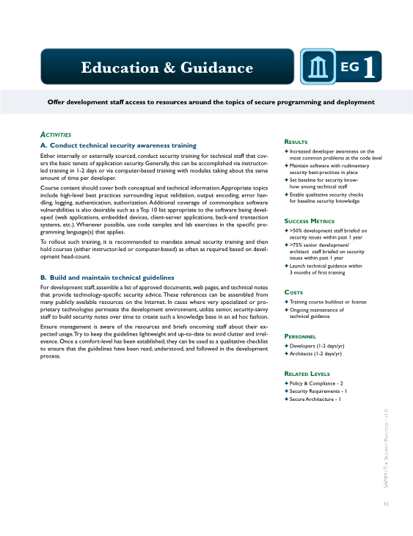
Per Level, SAMM defines...
Objective
Activities
Results
Success Metrics
Costs
Personnel
Related Levels

Slide 10
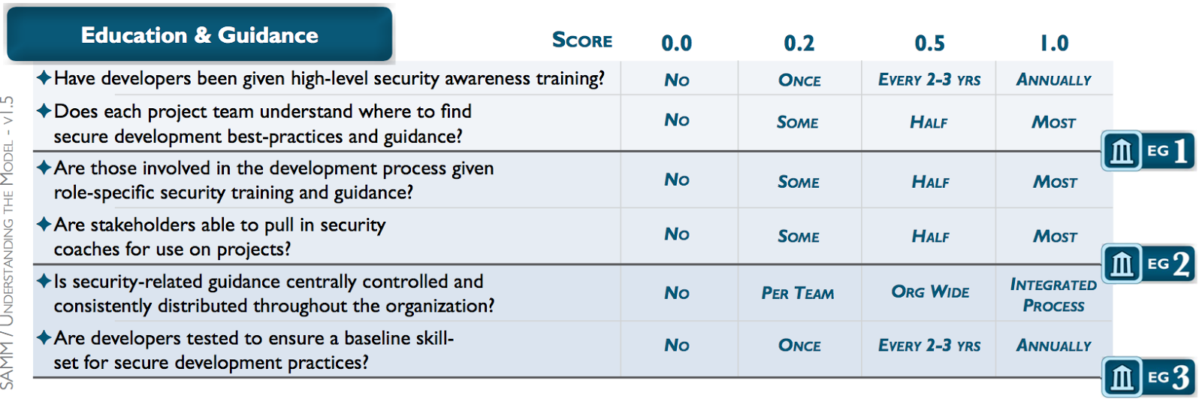
Assessments

Slide 11
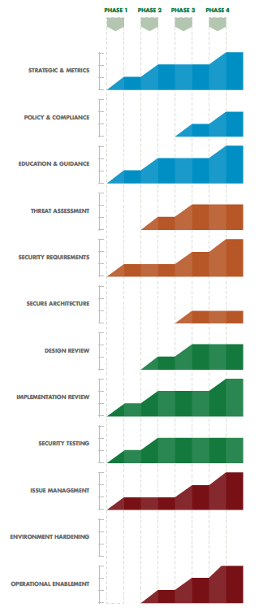
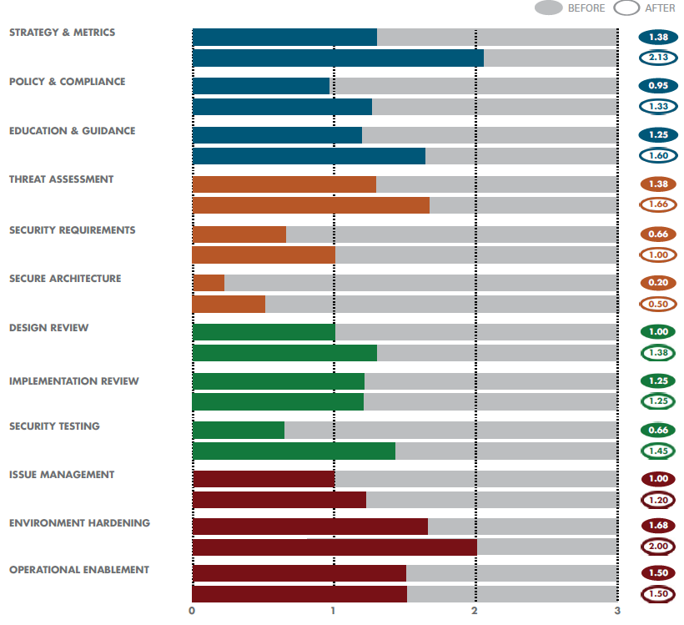
SAMM output

Slide 12
Why a new version?
Align with recent development practices
“Orphaned” activities
Method agnostic
Improve assessments
Improve SAMM release process
Backwards compatibility was not a goal

Slide 13
SAMM2 business functions
Governance
Design
Implementation
Verification
Operations

Slide 14
SAMM2 security practices
Governance
Strategy & Metrics
Policy & Compliance
Design
Threat Assessment
Security Requirements
Implementation
Secure Build
Education & Guidance
Security Architecture
Secure Deployment
Defect Management
Verification
Architecture Assessment
Requirements Testing
Security Testing
Operations
Incident Management
Environment Management
Operational Management
Still 3 Security Practices per Business Function

Slide 15
SAMM v2.0 Core Framework
Governance
Strategy & Metrics | Create and Promote | Measure and Improve
Policy & Compliance | Policy and Standards | Compliance Management
Education & Guidance | Training and Awareness | Organization and Culture
Design
Threat Assessment | Application Risk Profile | Threat Modeling
Security Requirements | Software Requirements | Supplier Security
Secure Architecture | Architecture Design | Technology Management
Implementation
Secure Build | Build Process | Software Dependencies
Secure Deployment | Deployment Process | Secret Management
Defect Management | Defect Tracking (Flaws/Bugs/Process) | Metrics and Feedback/Learning
Verification
Architecture Assessment | Architecture Validation | Architecture Compliance
Requirements Testing | Control Verification | Misuse/Abuse Testing
Security Testing | Scalable Baseline | Deep Understanding
Operations
Incident Management | Incident Detection | Incident Response
Environment Management | Configuration Hardening | Patching and Updating
Operational Management | Data Protection | System decommissioning / Legacy management

Slide 16
SAMM2 security practice structure Requirements Testing
Streams
 | A: Control Verification | B: Misuse /Abuse Testing
Level 1 - Opportunistically find basic vulnerabilities and other security issues. | Test for standard security controls | Perform security fuzzing testing
Level 2 - Perform implementation review to discover application-specific risks against the security requirements. | Derive test cases from known security requirements | Create and test abuse cases and business logic flaw test
Level 3 - Maintain the application security level after bug fixes, changes or during maintenance | Perform regression testing (with security unit tests) | Denial of service and security stress testing
Maturity
Activities
Notes:
fixme security practice

Slide 17
Scoring in SAMM v1.5
Strategy & Metrics, Level 1: Is there a software security assurance program in place?
Available Responses:
No
Yes, it‘s less than a year old
Yes, it‘s a number of years old
Yes, it‘s a pretty mature program
But, what about…
Quality of the program?
Freshness of the program? Has it been reviewed/updated?
How do you know the program is still relevant?

Slide 18
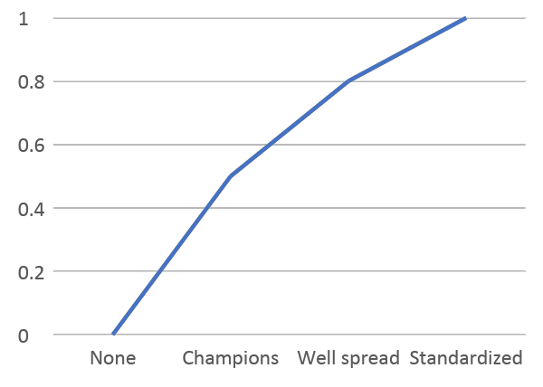
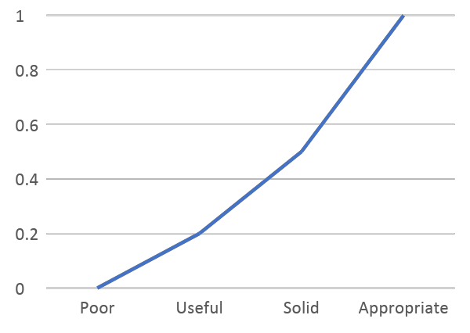
Multiple dimensions to consider
Coverage
Quality
SAMM2: Questions
SAMM2: Quality criteria (mandatory)

Slide 19
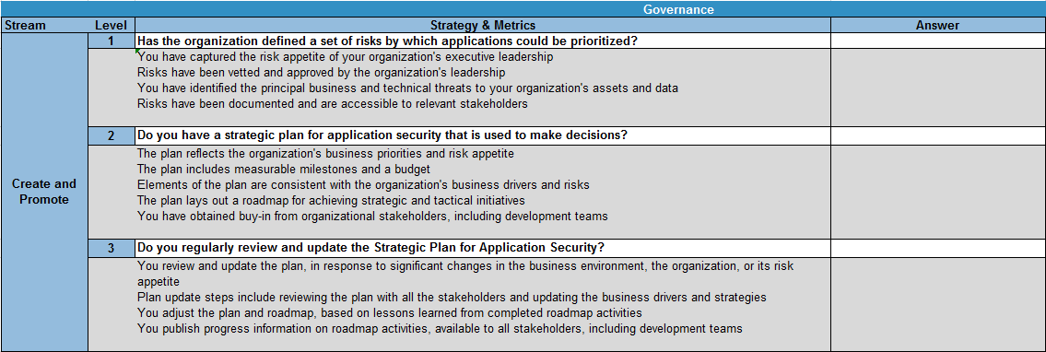
SAMM2 assessments
SAMM2 Toolbox:
https://github.com/OWASP/samm/tree/master/Supporting%20Resources/v2.0/toolbox

Slide 20
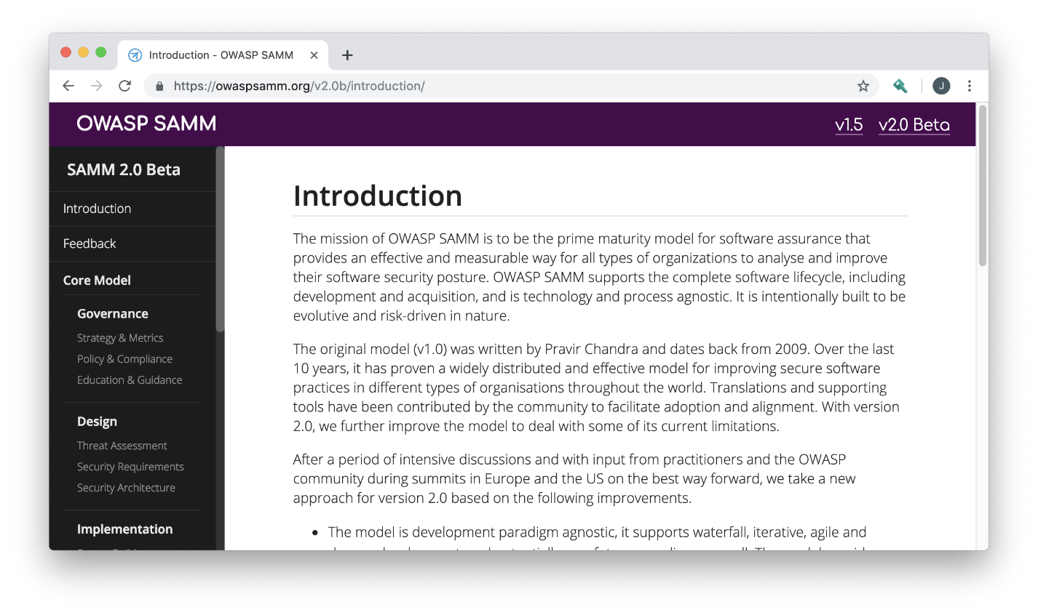
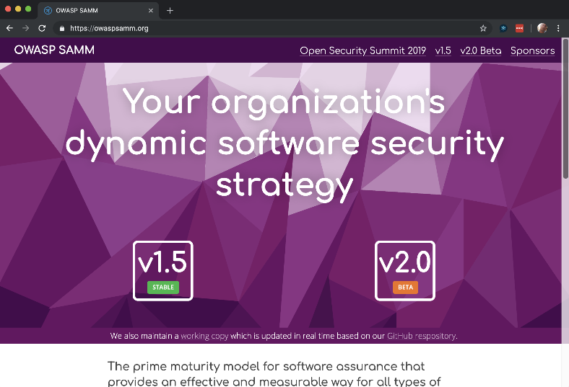
Owaspsamm.org and toolbox demo
Notes:
Let’s walk through demo of owaspsamm.org website and the SAMM toolbox.

Slide 21
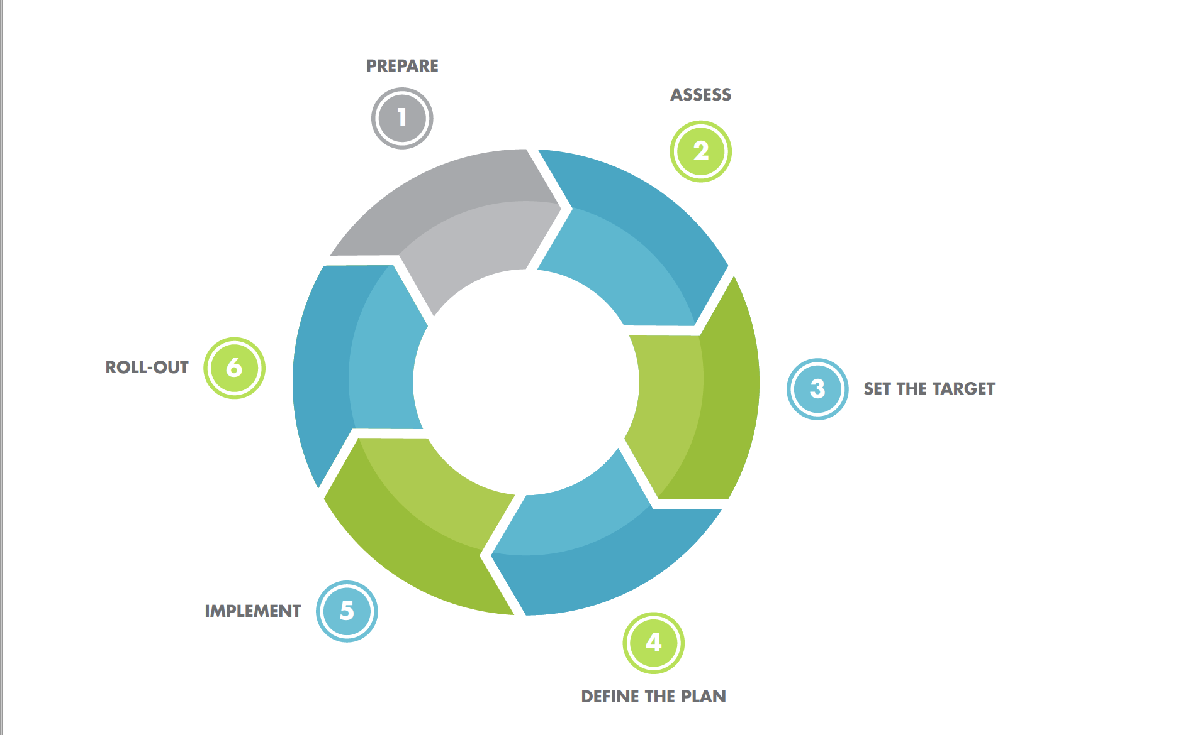
How to use SAMM?
Quick-Start Guide
Notes:
Quick Start Guide

Slide 22
Project: new way of working
Single source of the truth (Github)
Used to generate everything automatically
Document, website
Toolbox
Applications

Slide 23
Community involvement
Core Structure
BF’s, practices, streams
Evaluation Model
Questions, quality criteria, measurement model
Project driven
Activity Model
Objectives, Activities, dependencies, metrics, ...
Community feedback
Supporting information / tools
Guidance, references, supporting tools, ...
Community driven

Slide 24
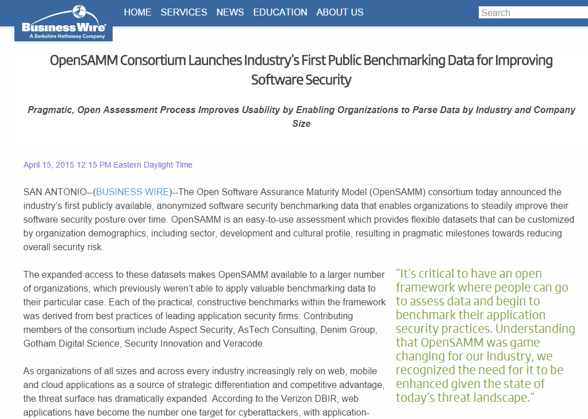
How do I compare to?

Slide 25
Current roadmap
V2.0: end of 2019
2020:
v2.1, 2.2, ...: iterative releases
Agile/devops guidance
Roadshows/trainings

Slide 26
Looking forward
OWASP projects references
Online assessments, integrated with benchmark data
User community contributions
Support for regulations
SAMM user summits
...

Slide 27

Try it !

Slide 28
Questions? Feedback? Input?
#project-samm
github.com/OWASP/samm

Slide 29
SAMM newsletter
eepurl.com/gl9fb9

Slide 30
Credits
Bart De Win – Project Co-Leader, Belgium
Sebastien (Seba) Deleersnyder – Project Co-Leader, Belgium
Brian Glass – United States
Daniel Kefer – Germany
Yan Kravchenko – United States
Chris Cooper – United Kingdom
John DiLeo – New Zealand
Nessim Kisserli – Belgium
Patricia Duarte - Uruguay
John Kennedy - Sweden
Hardik Parekh - United States
John Ellingsworth - United States
Sebastian Arriada - Argentina
Brett Crawley – United Kingdom
...

Slide 31



Thank You to Our Sponsors
Notes:
Thank you to our Sponsors. There are more Sponsorship opportunities still available! Please contact us if you would like to be a project sponsor.

Slide 32
SUPPORT OWASP SAMM
Software powers the world,
but insecure software threatens safety, trust, and economic growth.

Slide 33
Call for sponsors
All proceeds from the sponsorship support the mission of the OWASP foundation and the further development of SAMM, funding
marketing & PR support
technical editing & UX support
website development and hosting
SAMM user summits
core team summits
tooling for the SAMM Benchmark project
info@owaspsamm.org

Slide 34

Questions or Feedback ?

Slide 35
Thank you
info@owaspsamm.org seba@owasp.org

